Slide 1

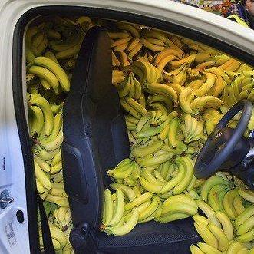
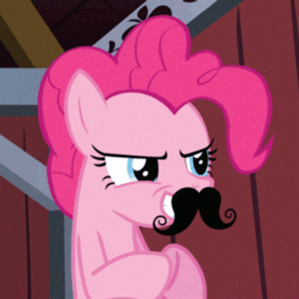

It’s Pokemon Go meets Amazon Smile meets Mafia Wars.

Slide 2
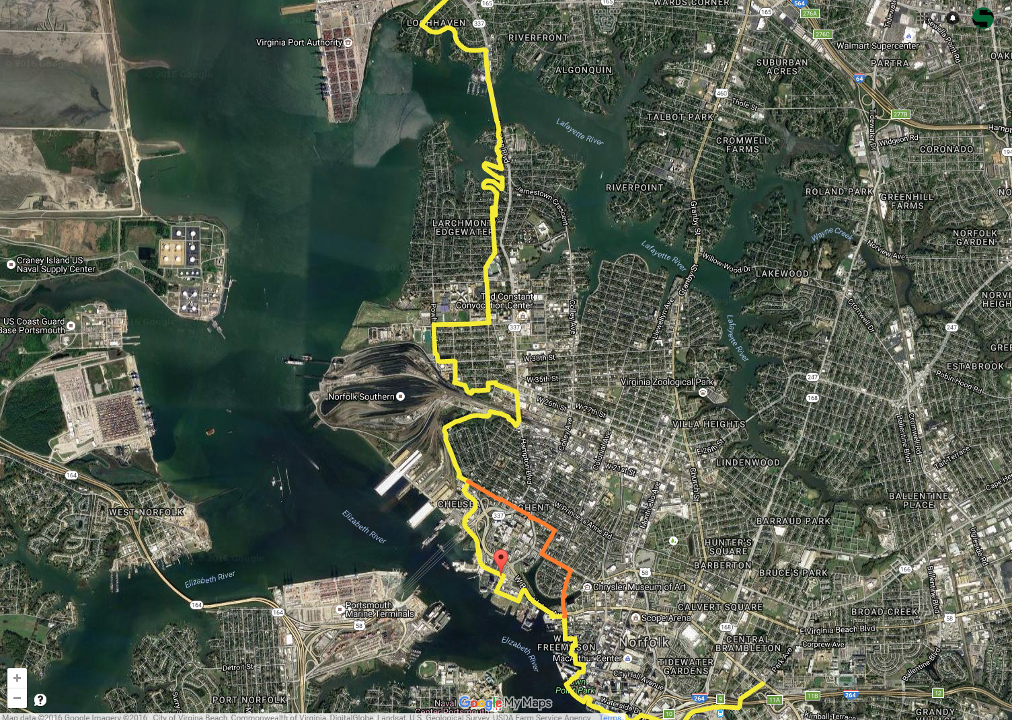












Slide 3
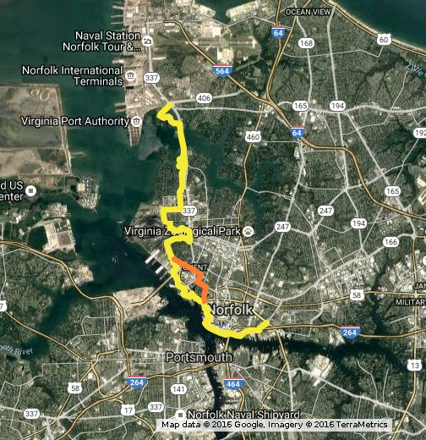
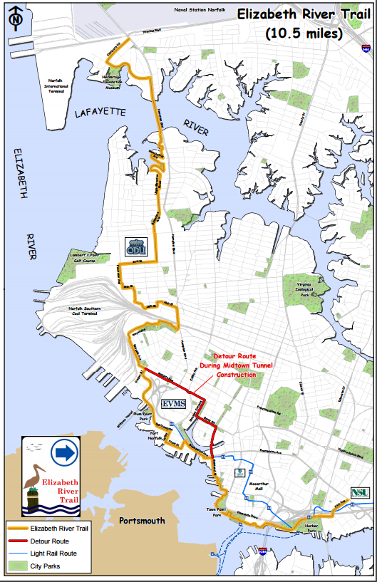

Slide 4
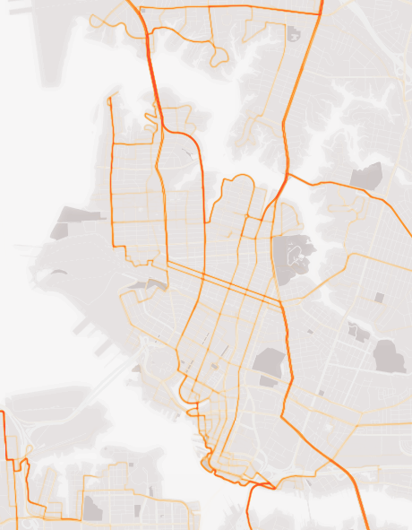

Slide 5


Slide 6
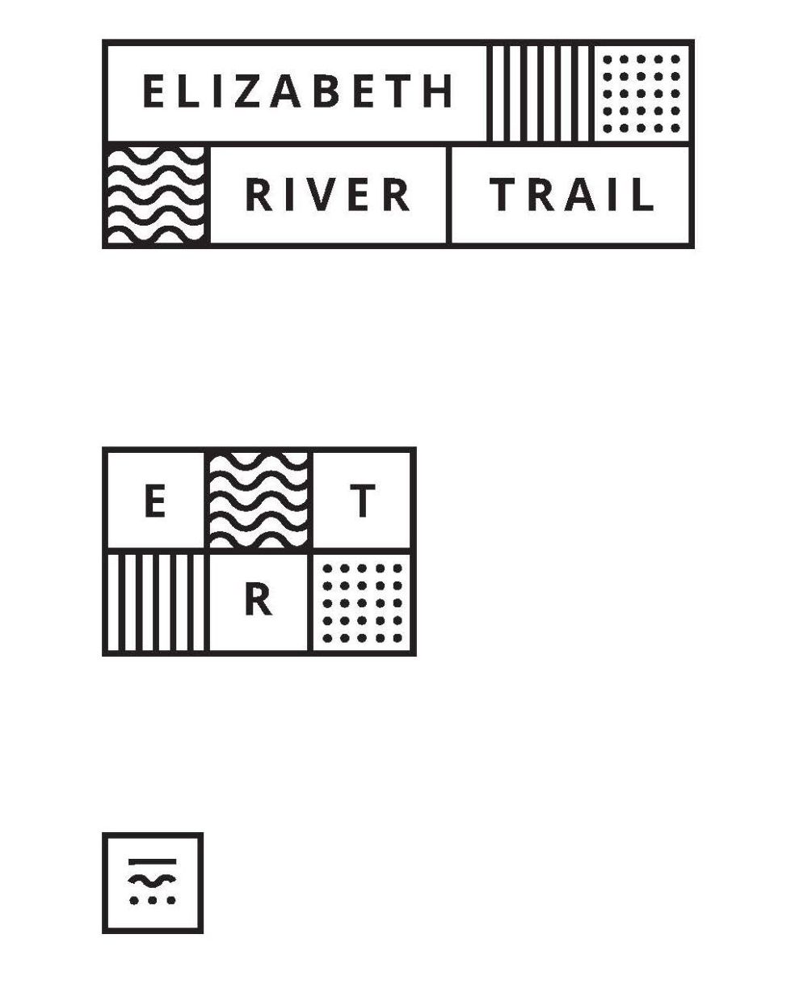







Slide 7
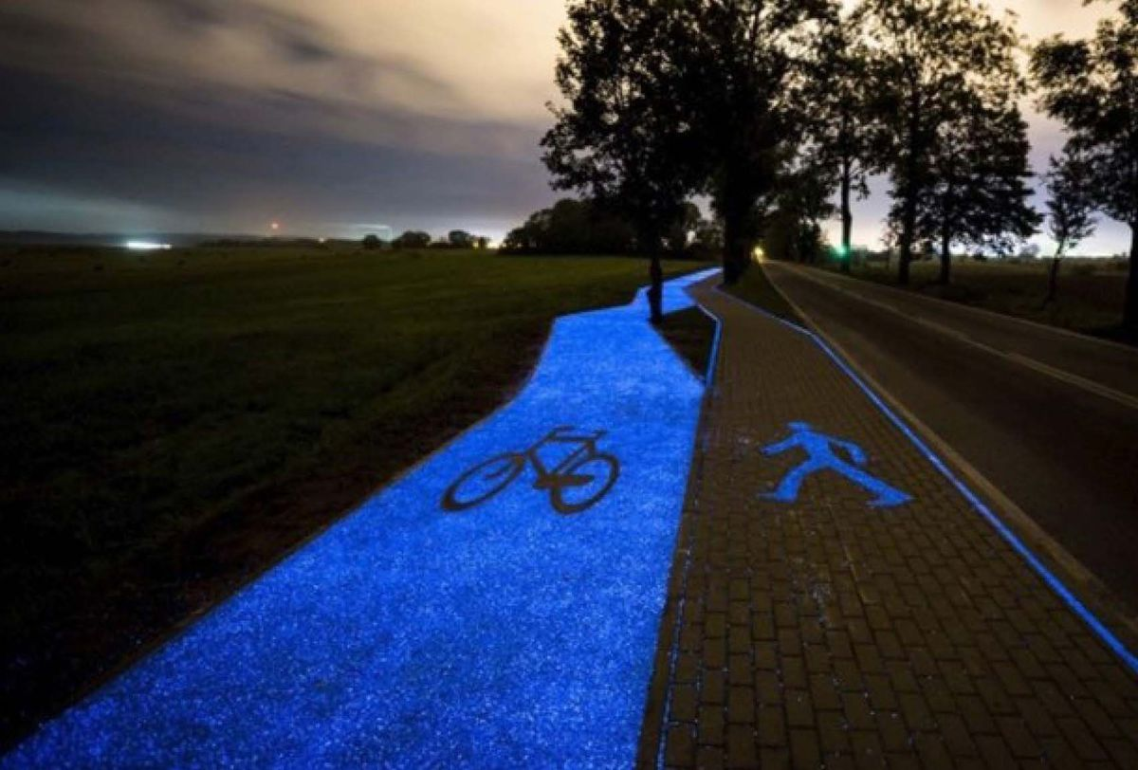

Slide 8
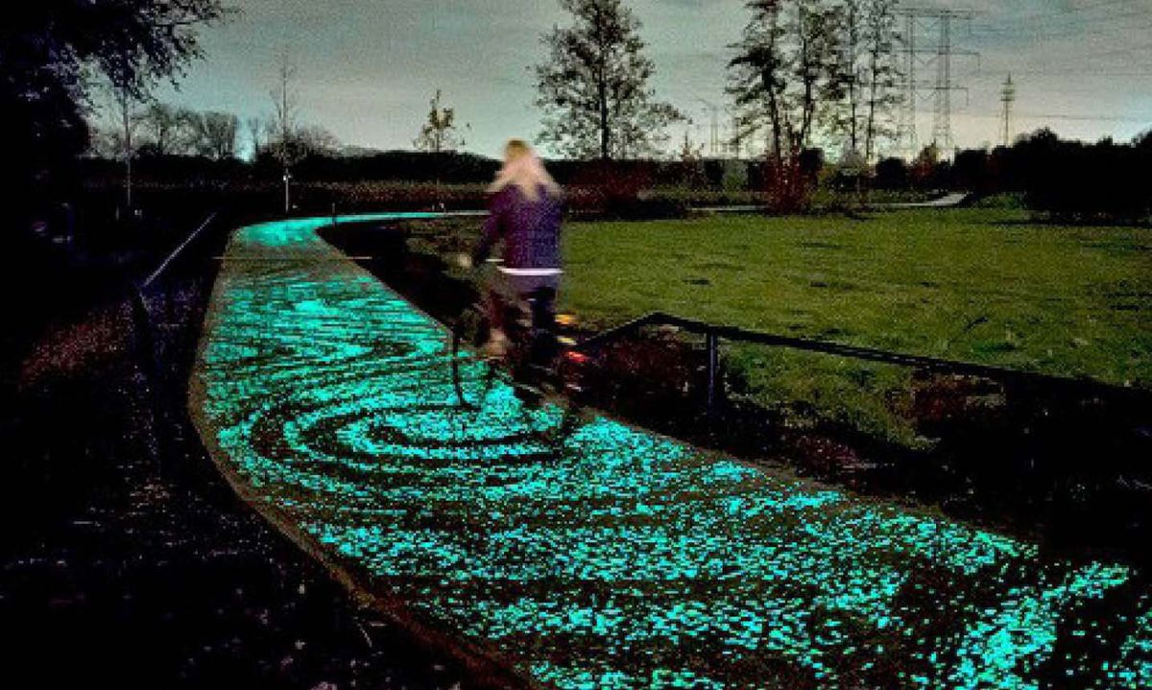

Slide 9
Vice Mayor Theresa Whibley, who will be on the new foundation’s board, said surveys have shown that few residents know the trail exists. Parts of it run through neighborhood streets or major thoroughfares, so people might have ridden it without even knowing.
Pilot story

Slide 10
The vision calls for charging stations, free Wi-Fi, water fountains, solar-powered lighting, benches and public art to make the trail more inviting.

Slide 11
Sure enough, when those behind the new foundation spoke Thursday to a group of business leaders, they said improving the trail will keep millennials in Norfolk – and draw new ones, especially those in technology or creative fields.

Slide 12
Business candidates (7 pairs of similar businesses)
Smartmouth Brewery | 36.866322, -76.309673 | Bold Mariner Brewery | 36.875962, -76.305480
Vintage Kitchen | 36.843186, -76.287802 | Pagoda Restaurant | 36.849767, -76.294772
Machismo | 36.853324, -76.296426 | Voila! | 36.853137, -76.296210
Starbucks | 36.886353, -76.306709 | Chick-fil-A | 36.886954, -76.306336
Sheraton Norfolk Waterside | 36.843704, -76.289623 | Norfolk Waterside Marriott | 36.845554, -76.290969
Dockside Bar & Grill | 36.917298, -76.309400 | Orapax Restaurant | 36.867414, -76.308270
757 Crave | 36.857492, -76.304048 | Hummingbird Macaroons | 36.852899, -76.296171

Slide 13
ERT zip codes
23504 23510 23507 23517 23508 23505

Slide 14
Beneficial Byproducts of the Game
ERT publicity
Charity publicity
Community engagement - citizens and select businesses
Incentivize privately funded trail improvements and sponsorship
Player data mining
Foot traffic (trail usage)
Wifi coverage (vision goal #2)
Overall behavior
Spending habits
Targeted survey questions in-game
Amenity usage
Relative social cause importance
Advance field of game theory
Thought experiment on human behavior to drive sociological advance

Slide 15
Store history csv (1 file)
StoreName,lat,long,Jan14,Feb14,Mar14,Apr14,May14,Jun14,Jul14,Aug14,Sep14,Oct14,Nov14,Dec14,Jan15,Feb15,Mar15,Apr15,May15,Jun15,Jul15,Aug15,Sep15,Oct14,Nov14,Dec14,
Smartmouth Brewery,36.866322,-76.309673,Red,Blue,Red,Blue,Blue,Red,Blue,Blue,Red,Blue,Red,Blue,Red,Red,Blue,Blue,Blue,Blue,Red,Blue,Blue,Blue,Blue,Blue,
Bold Mariner Brewery,36.875962,-76.305480,Red,Blue,Red,Blue,Blue,Blue,Red,Red,Blue,Red,Red,Red,Red,Blue,Blue,Red,Blue,Blue,Blue,Blue,Blue,Red,Red,Red,
757 Crave,36.857492,-76.304048,Red,Blue,Red,Blue,Blue,Red,Red,Blue,Blue,Blue,Red,Blue,Blue,Blue,Blue,Red,Red,Red,Blue,Red,Red,Blue,Red,Blue,
Vintage Kitchen,36.843186,-76.287802,Red,Blue,Red,Blue,Red,Blue,Blue,Red,Blue,Red,Red,Blue,Red,Blue,Red,Red,Red,Red,Red,Red,Blue,Blue,Red,Red,
Pagoda Restaurant,36.849767,-76.294772,Red,Blue,Red,Blue,Blue,Red,Blue,Red,Red,Blue,Blue,Red,Blue,Blue,Blue,Blue,Blue,Red,Red,Blue,Blue,Blue,Red,Red,
Machismo,36.853324,-76.296426,Red,Blue,Red,Blue,Red,Blue,Blue,Red,Blue,Red,Red,Red,Red,Red,Red,Red,Blue,Blue,Red,Blue,Blue,Blue,Blue,Red,
Voila!,36.853137,-76.296210,Red,Blue,Red,Blue,Blue,Blue,Blue,Blue,Blue,Blue,Red,Blue,Red,Blue,Red,Red,Red,Blue,Blue,Blue,Blue,Blue,Blue,Blue,
Starbucks,36.886353,-76.306709,Red,Blue,Red,Blue,Red,Red,Blue,Blue,Blue,Blue,Red,Red,Blue,Red,Blue,Red,Blue,Red,Blue,Red,Blue,Red,Red,Blue,
Chick-fil-A,36.886954,-76.306336,Red,Blue,Red,Blue,Red,Blue,Blue,Blue,Blue,Blue,Red,Blue,Red,Red,Red,Red,Red,Blue,Red,Blue,Blue,Red,Blue,Blue,
Sheraton Norfolk Waterside,36.843704,-76.289623,Red,Blue,Red,Blue,Blue,Blue,Blue,Blue,Blue,Red,Blue,Red,Red,Red,Blue,Red,Red,Blue,Red,Red,Blue,Red,Red,Red,
Dockside Bar & Grill,36.917298,-76.309400,Red,Blue,Red,Blue,Red,Blue,Red,Blue,Red,Red,Red,Blue,Blue,Red,Red,Blue,Red,Red,Red,Blue,Red,Red,Blue,Red,
Orapax Restaurant,36.867414,-76.308270,Red,Blue,Red,Blue,Blue,Blue,Blue,Red,Red,Blue,Red,Blue,Blue,Blue,Blue,Red,Blue,Red,Blue,Red,Blue,Red,Red,Red,
Hummingbird Macaroons,36.852899,-76.296171,Red,Blue,Red,Blue,Red,Blue,Red,Red,Blue,Blue,Blue,Blue,Red,Red,Blue,Red,Blue,Blue,Blue,Blue,Blue,Blue,Blue,Blue,
Norfolk Waterside Marriott,36.845554,-76.290969,Red,Blue,Red,Blue,Blue,Blue,Red,Blue,Blue,Red,Red,Red,Red,Blue,Blue,Red,Blue,Blue,Red,Red,Red,Blue,Blue,Blue

